Slide 1
Azure DocumentDB
Santosh Tiwari
Solution Architect
March 5, 2017

Slide 2
Agenda
Overview
NoSQL and DocumentDB
Value Proposition
Azure DocumentDB Basics
Demo: Account Creation
Queries, transactions, indexing, Security
Management
Tools
Summary

Slide 3
Agenda
Overview
NoSQL and DocumentDB
Value Proposition
Azure DocumentDB Basics
Demo: Account Creation
Queries, transactions, indexing, Security
Management
Tools
Summary

Slide 4
What is NoSQL?
A database solution designed to compensate for the technical limitations of SQL
NoSQL
Choose the store that best fits your needs
SQL

Slide 5
Traditional approach: relational stores
Data is stored in tables that comprise:
Schemas
Columns
Rows
Chappell & Associates. “Understanding NoSQL on Microsoft Azure.” 2014. http://www.davidchappell.com/writing/white_papers/Azure-NoSQL-Technologies-v2.0--Chappell.pdf.
Image based on: PricewaterhouseCoopers. “Data models in NoSQL and NewSQL databases.” 2015 http://www.pwc.com/us/en/technology-forecast/2015/remapping-database-landscape/features/assets/data-models-production.pdf

Slide 6
NoSQL approach: various types of stores
A NoSQL database uses four categories of stores:
Azure DocumentDB
Uses all but graph category
Includes some key-value and columnstore capabilities
Key value
Wide column
Document
Graph
PricewaterhouseCoopers. “Data models in NoSQL and NewSQL databases.” 2015 http://www.pwc.com/us/en/technology-forecast/2015/remapping-database-landscape/features/assets/data-models-production.pdf

Slide 7
Key-value stores
Key-value stores offer high speed through the least-complicated data model—anything can be stored as a value, as long as each value is associated with a key or name.
Key
Value
Image based on: PricewaterhouseCoopers. “Data models in NoSQL and NewSQL databases.” 2015 http://www.pwc.com/us/en/technology-forecast/2015/remapping-database-landscape/features/assets/data-models-production.pdf

Slide 8
Wide-column stores
Wide-column stores are fast and can be almost as simple as key-value stores. They include a primary key, an optional secondary key, and anything stored as a value.
Values
Keys and values can be sparse or numerous
Primary key
Secondary key
Image based on: PricewaterhouseCoopers. “Data models in NoSQL and NewSQL databases.” 2015 http://www.pwc.com/us/en/technology-forecast/2015/remapping-database-landscape/features/assets/data-models-production.pdf

Slide 9
Graph databases
Title: Forgotten Bridges
Name:
Ian
Purchased
Date: 03/02/2011
Title: Mythical
Bridges
Purchased
Date: 05/07/2011
Purchased
Date: 09/09/2011
Name:
Alan
Image based on: PricewaterhouseCoopers. “Data models in NoSQL and NewSQL databases.” 2015 http://www.pwc.com/us/en/technology-forecast/2015/remapping-database-landscape/features/assets/data-models-production.pdf

Slide 10
Document stores
Document stores contain data objects that are inherently hierarchical, tree-like structures (most notably JavaScript Object Notation [JSON] or Extensible Markup Language [XML]).
Note that these are not Microsoft Word documents!
Image based on: PricewaterhouseCoopers. “Data models in NoSQL and NewSQL databases.” 2015 http://www.pwc.com/us/en/technology-forecast/2015/remapping-database-landscape/features/assets/data-models-production.pdf

Slide 11
NewSQL: another variation
Relational NewSQL stores are designed for web-scale applications, but they still require up-front schemas, joins, and table management that can be labor intensive.
Image based on: PricewaterhouseCoopers. “Data models in NoSQL and NewSQL databases.” 2015. http://www.pwc.com/us/en/technology-forecast/2015/remapping-database-landscape/features/assets/data-models-production.pdf.

Slide 12
Why NoSQL evolved
Drivers
Operational efficiency
Resiliency
Scalability
Speed and variety of cloud-based data
Image based on: PricewaterhouseCoopers. “Data models in NoSQL and NewSQL databases.” 2015 http://www.pwc.com/us/en/technology-forecast/2015/remapping-database-landscape/features/assets/data-models-production.pdf

Slide 13






SQL and NoSQL: each has its place
SQL Server in a VM
Azure SQL Database
Azure DocumentDB
Apache HBase
Tables/Blobs
Fully featured RDBMS
RichQuery
Transactional processing
Managed as a service
Elastic scale
Schema-free data model
Internet-accessible http/rest
Arbitrary data formats

Slide 14

Azure DocumentDB
A NoSQL document database-as-a-service, fully managed by Azure
Azure DocumentDB Document store
{
"name": "John",
"country": "Canada",
"age": 43,
"lastUse": "March 4, 2014"
}
{
"name": "Eva",
"country": "Germany",
"age": 25
}
JSON
DOCUMENT 1
DOCUMENT 2
{
"name": "Lou",
"country": "Australia",
"age": 51,
"firstUse": "May 8, 2013"
}
{
"docCount": 3,
"last": "May 1, 2014"
}
Application
SQL query
DOCUMENT 3
DOCUMENT 4
Perfect for cloud architects and developers who need an enterprise-ready NoSQL document database

Slide 15
Azure DocumentDB details
Ideal for apps designed for the cloud when the following are high priorities:
RichQuery and transactions over JSON data
Query JSON data with no secondary indices
Reliable and predictable performance
Tunable consistency
Elastic scale
Rapid development
Build with familiar tools—REST, JSON, JavaScript
Native support for JavaScript, SQL query, and transactions over JSON documents

Slide 16
Agenda
Overview
NoSQL and DocumentDB
Value Proposition
Azure DocumentDB Basics
Demo: Account Creation
Queries, transactions, indexing, Security
Management
Tools
Summary

Slide 17
Today’s modern apps
Produce and consume data at a staggering rate
Require instantaneous response times to match user expectations
Are developed iteratively with many versions supported concurrently
Are developed with continuously evolving data models
Are increasingly complex
Experience unpredictable and explosive growth

Slide 18




Azure DocumentDB case studies
Next Games uses Azure DocumentDB for the persistence layer of The Walking Dead: No Man’s Land. Azure DocumentDB supports the massive scalability and responsiveness required for the best user experience.
Azure DocumentDB supports scalability in the data tier and rapid iterative development of new features. The Halo development team chose Azure DocumentDB due to the speed and flexibility offered by its automatic indexing capabilities.
“Azure helps SSB deliver a powerful, effective, user-friendly, cost-appropriate solution to markets that are highly cost sensitive and in need of the SSB solution.”
Treye Johnson SSB Director of Marketing and Product
“We find that we work with Azure DocumentDB more intuitively than we do with something like MongoDB. We also estimate that we saved approximately 70 percent in implementation costs.”
Mick Badran Breeze Chief Technology Officer

Slide 19




Azure DocumentDB case studies continued
“We have built micro-personalization and macro-interactivity into our app with Azure DocumentDB. This is definitely a great way to get more people using the app and keep existing users interested.“
Marc Tonnes News Republic, Database Administrator
“The teams no longer worry about having to coordinate their work. And we don’t have to manage the hardware—Microsoft does that in the cloud and, given their SLAs, this makes perfect sense.”
Shane Davis SGS International Senior Director
“With Azure DocumentDB, we didn’t have to say ‘no’ to the business, and we weren’t a bottleneck to launching the promotion—in fact, we came in ahead of schedule.”
Andreas Helland Telenor
Mobility Architect
“But we can’t run our highest resources all the time. With Azure DocumentDB and Azure Search, we can scale dynamically to meet spikes in demand and pay only for what we consume.”
Daron Yöndem
XOMNI
Chief Technology Officer

Slide 20

Azure DocumentDB at Microsoft
More than 450 million unique users
Store 20 TB of JSON document data
Available globally to serve all markets
USER DATA STORE
Store for 40+ app/device combinations
Under 15 millisecond (ms) writes and single-digit ms reads

Slide 21
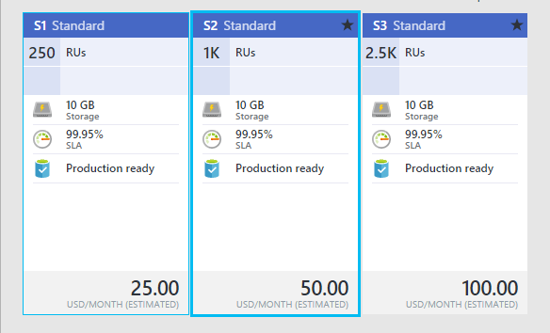
What does DocumentDB cost?
Pricing for General Availability
Standard pricing tier with hourly billing
S1, S2 and S3 units differentiated by performance (good, better, best)
Performance levels assigned during collection (data partition) creation
Performance levels can be adjusted based on application needs
Each collection includes 10GB of SSD storage
Limit of 100 collections (1 TB) for each account – can be lifted as needed

Slide 22
Agenda
Overview
NoSQL and DocumentDB
Value Proposition
Azure DocumentDB Basics
Demo: Account Creation
Queries, transactions, indexing, Security
Management
Tools
Summary

Slide 23

Azure DocumentDB basics
Resource model
Entities addressable by logical Uniform Resource Identifier (URI)
Partitioned for scale out
Replicated for high availability
Entities represented as JSON
Accounts scale out by moving a slider
Interaction model
RESTful interaction over HTTPS
HTTPS and TCP connectivity
Standard HTTPS verbs and semantics
Development
.NET, Node.js, Python, Java, and JavaScript clients
SQL for query expression, .NET LINQ
JavaScript for server-side app logic
Azure DocumentDB account
Databases
Collections
Documents
Attachments
{ }
101
010
{ }
Users
Stored procedures
Your documents here
JS
Permissions
Triggers
JS
User-defined functions
JS

Slide 24
Azure DocumentDB collections
Collections != tables
Unit of partitioning
Transaction boundary
No enforced schema, flexible
Queried or updated stay together in one collection
Elasticity to 10 GB
RUs evenly distributed across partitions
Collections
Documents
Attachments
101
010
Stored procedures
Your documents here
JS
Triggers
JS
User-defined functions
JS

Slide 25
DocumentDB JSON documents
{
“locations”:
[
{“country”: “Germany”, “city”: “Berlin”},
{“country”: “France”, “city”: “Paris”},
],
“headquarter”: “Belgium”,
“exports”:[{“city”: “Moscow”},{“city”: “Athens”}]
}
JSON document as tree
JSON
Intersection of most modern type systems
JSON values
Self-describable, self-contained values
Are trivially serialized to/from text
DocumentDB makes a deep commitment to JSON for storage, indexing, query, and JavaScript execution
Locations
Headquarter
Exports
0
1
Belgium
0
1
Country
City
Country
City
City
City
Germany
Berlin
France
Paris
Moscow
Athens

Slide 26
Data modeling with RDBMS
Doing it the RDBMS way: normalize, normalize, normalize…
Joins needed to query for Person with related tables
SELECT p.name, p.lastName, p.age,
cd.detail , cdt.type, a.street, a.city,
a.state, a.zip
FROM Person p INNER JOIN Address a
ON a.person_id = p.id INNER JOIN ContactDetail cd
ON cd.person_id = p.id INNER JOIN ContactDetailType cdt
ON cd.type_id = cdt.id
Updating Person, ContactDetail, and Address requires updates to many tables
Person
id
name
lastname
age
Contact Detail
id
person_id
type_id
detail
Contact Detail Type
id
type_id
Address
id
person_id
street
city
state
zip

Slide 27
Data modeling with denormalization
{
id_: <ObjectId1>,
username: "123xyz",
contact:
{
phone: "555-121-1212",
email: "xyx@abc.com"
},
access:
{
level: 5,
group: "dev"
}
}
Applications may need to issue fewer queries and updates
Generally, use embedded data models when:
There are “contains” relationships between entities
There are one-to-few relationships between entities
Embedded data changes infrequently
Embedded data won’t grow without bound
Embedded data is integral to data in a document
Denormalizing typically provides better read performance

Slide 28
Data modeling with referencing
Contact document
In general, use normalized data models when:
Write performance for duplication is more important
Representing one-to-many relationships
Representing many-to-many relationships
Related data changes frequently
Provides more flexibility than embedding
More round trips
Normalizing typically provides better write performance
{
_id: <ObjectID2>,
user_id: <objectId1>,
phone: "555-121-1212",
email: "abc@cyx.com"
}
User document
{
_id: <OnjectID1>,
username: "123xyz"
}
Access document
{
_id: <ObjectID3>,
user_id: <objectId1>,
level: 5,
group: “dev"
}

Slide 29
Hybrid data modeling w/ embedding & referencing
Author document
Books document
We can use embedding and referencing to read and write data to documents.
The author document references books.
The books document includes Author names and thumbnail URLs.
Normalizing typically provides better write performance.
{
"id": 1,
"firstName": "Thomas",
"lastName": "Andersen",
"countOfBooks": 3,
"books": [1, 2, 3],
"images": [
{"thumbnail": "http://....png"}
]
}
{
"id": 1,
"name": "DocumentDB 101",
"authors": [
{"id": 1, "name": "Thomas Andersen", "thumbnailUrl": "http://....png"},
{"id": 2, "name": "William Wakefield", "thumbnailUrl": "http://....png"}
]
}

Slide 30
Agenda
Overview
NoSQL and DocumentDB
Value Proposition
Azure DocumentDB Basics
Demo: Account Creation
Query
Queries, transactions, indexing, Security
Management
Tools
Summary

Slide 31
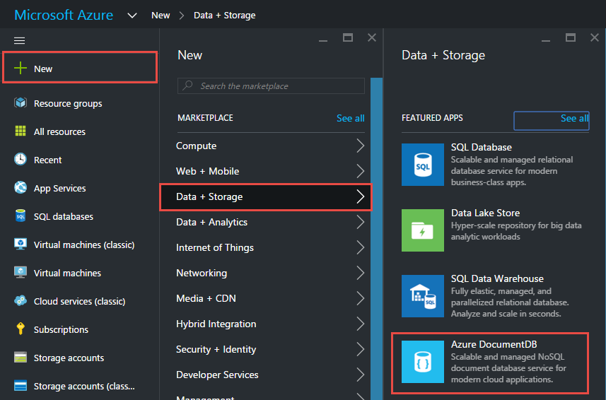
Create a new account
Start from the Azure portal to create a DocumentDB service under your Azure subscription.

Slide 32
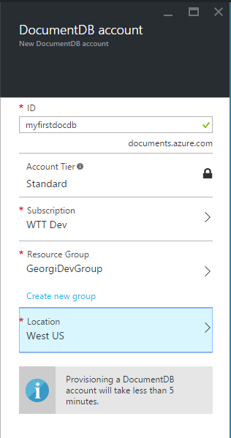
Provide the service name
Provide a name for your service that will be used as part of the endpoint URI.
You can also define resource groups, capacity units, and service location.

Slide 33
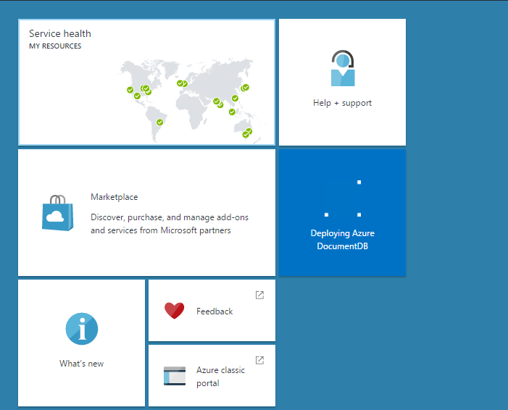
Complete provisioning
The Azure portal provides notifications to let you know the provisioning status.

Slide 34
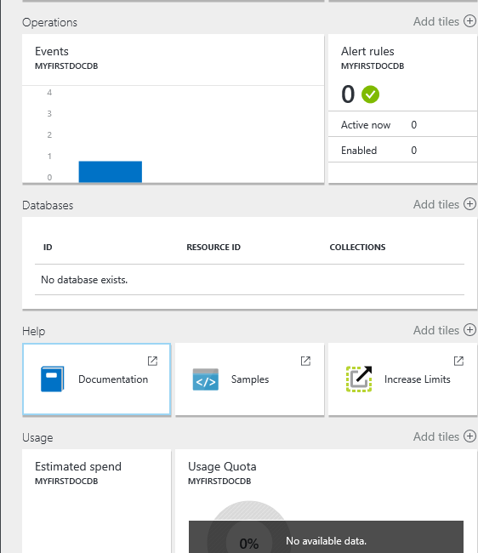
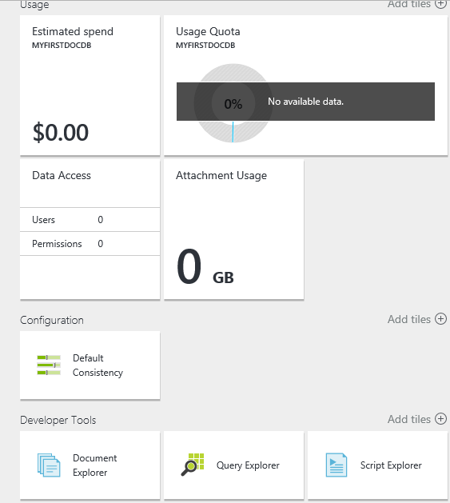
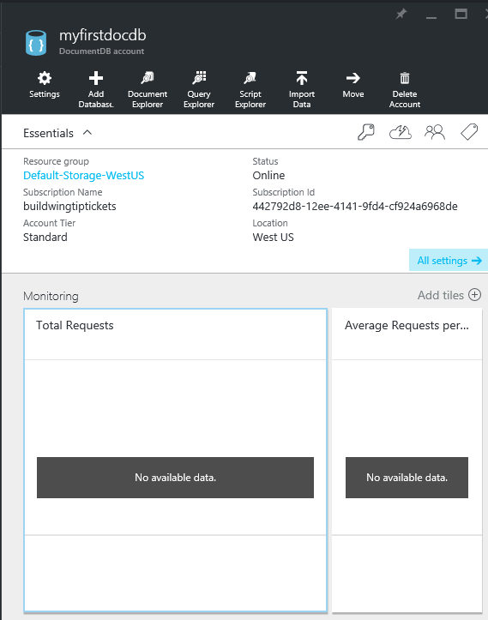
DocumentDB account blade
The account blade provides you with essential information about your service.
Check out DocumentDB Quick Start by clicking on All settings in the Essentials section of the blade.

Slide 35
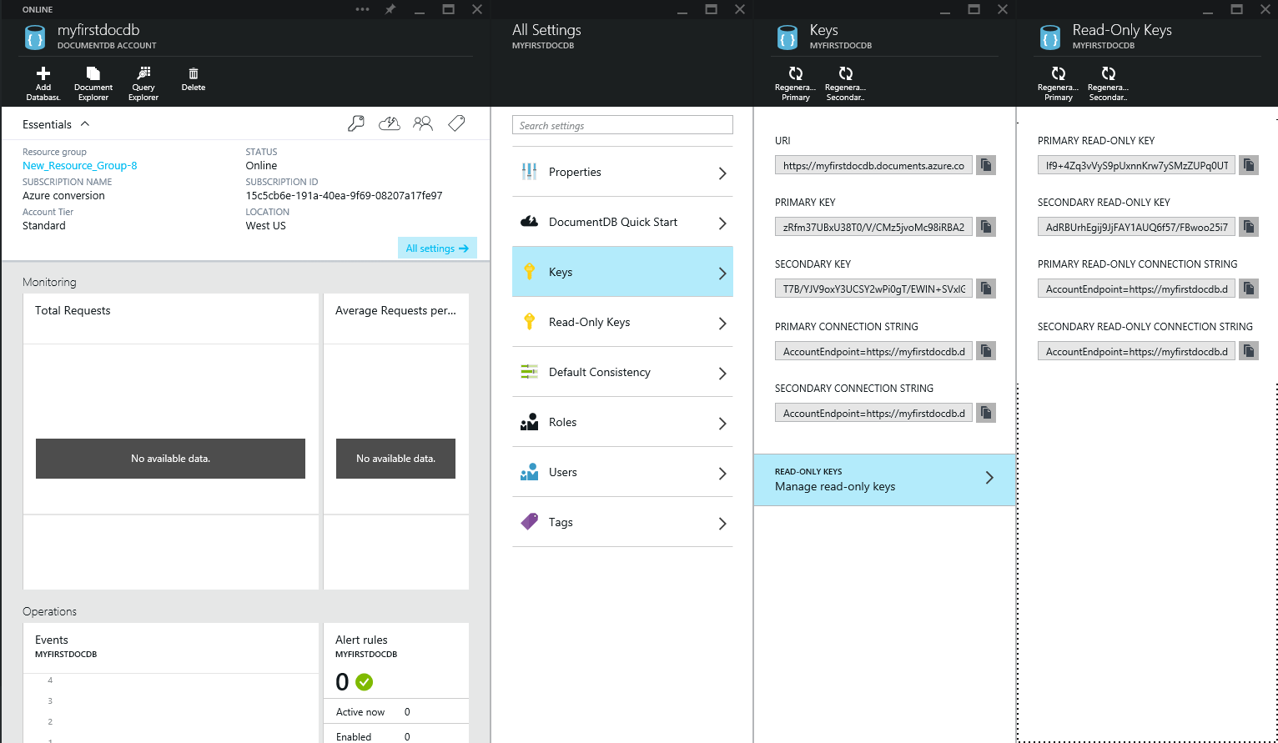
Viewing service keys
Click All settings to display the Keys and Read-Only Keys blades.
Use the URI and service keys in your application for the endpoint and authentication.
Like other services, DocumentDB includes primary and secondary keys for rolling key updates.

Slide 36
Agenda
Overview
NoSQL and DocumentDB
Value Proposition
Azure DocumentDB Basics
Demo: Account Creation
Queries, transactions, indexing, Security
Management
Tools
Summary

Slide 37
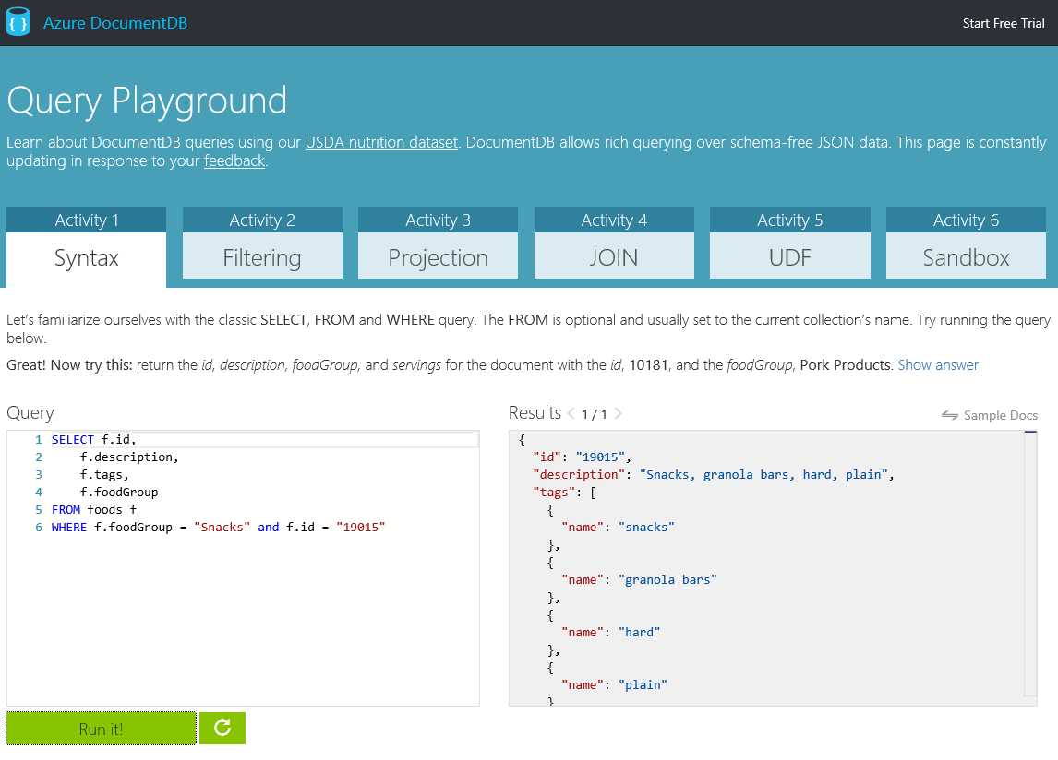
Using DocumentDB Query Playground
Go to http://www.documentdb.com/sql/demo
Test out sample queries or write your own against the dataset

Slide 38
Query with user-defined function
The complexity of a query impacts the request units consumed for an operation:
Number of predicates
In general, more predicates result in a larger request charge.
Additional predicates can help if they result in narrowing the overall result set.
Use of user-defined functions (UDFs)
To take advantage of indexing, try and have at least one filter against an indexed property when leveraging a UDF.
Tip: For all operations, the cost of any given request can be inferred by inspecting the x-ms-request-charge response header.
// User Defined Function
function tax(doc) {
// Use simple formula to compute the tax: use income multiplied by factor based on country of headquarters.
var factor =
doc.headquarters == "USA" ? 0.35 :
doc.headquarters == "Germany" ? 0.3 :
doc.headquarters == "Russia" ? 0.2 :
0;
// Check for bad data.
if (factor == 0)
{
throw new Error("Unsupported country: " +
doc.headquarters);
}
// Use simple formula and return.
return doc.income * factor;
}
// Execute UDF with additional condition
var results = client.CreateDocumentQuery<dynamic>(colSelfLink, string.Format("SELECT r.name AS company, Tax(r) AS tax FROM root r WHERE r.type='Company'", udfId));

Slide 39
JavaScript transactions
Transactionally process multiple documents with application-defined stored procedures and triggers
JavaScript as the procedural language
Language integrated
Execution wrapped in an implicit transaction
Preregistered and scoped to a collection
Performed with ACID guarantees
Triggers invoked as pre- or post-operations
JS
Stored procedures
Triggers

Slide 40
Four consistency levels
Lower consistency level on read operations
Document myDoc = await client.ReadDocumentAsync(documentLink, new RequestOptions { ConsistencyLevel = ConsistencyLevel.Eventual });
Strong
Session
Bounded Staleness
Eventual

Slide 41
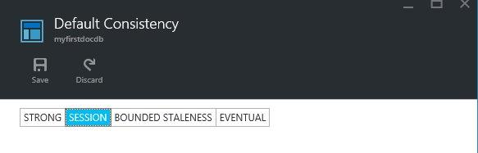
Consistency levels enable guarantees
Choose your consistency level and make predictable trade-offs between consistency, availability, and performance
Choose your level
Strong
Data consistency
Session
Monotonic reads (on explicit read requests) and writes
Bounded Staleness Total order of propagation of writes
Eventual Lowest latency for reads and writes

Slide 42
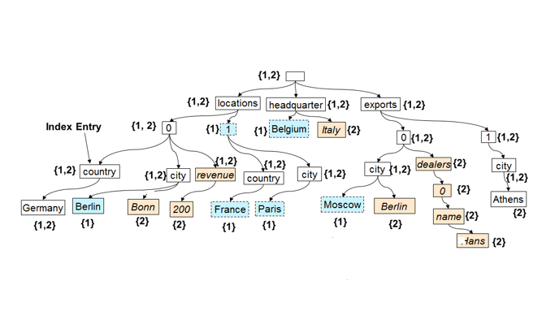
Indexing
value
The “write” index for consistent queries
Highly concurrent, lock-free, log-structured indexing technology developed with Microsoft Research
Optimized for solid-state drives (SSDs)
Resource-governed for tenant isolation
Automatic indexing of JSON documents without requiring schema or secondary indices, but configurable via:
Modes
Paths
Types
string
numbers
object
array
true
false
null
object
{
string
:
value
}
,
array
{
value
}
,

Slide 43
Indexing – modes and policies
Set indexing mode
Indexing modes
Consistent
Default mode
Index updated synchronously on writes
Lazy
Useful for bulk ingestion scenarios
Indexing policies
Automatic
Default
Manual
Can choose to index documents via RequestOptions
IndexingDirective = IndexingDirective.Include
Can read non-indexed documents via selflink
var collection = new DocumentCollection
{
Id = “lazyCollection”
};
collection.IndexingPolicy.IndexingMode = IndexingMode.Lazy;
collection = await client.CreateDocumentCollectionAsync(databaseLink, collection);
Set indexing policy
var collection = new DocumentCollection
{
Id = “manualCollection”
};
collection.IndexingPolicy.Automatic = false;
collection = await client.CreateDocumentCollectionAsync(databaseLink, collection);

Slide 44
Indexing – paths and types
Setting paths, types, and precision
Index paths
Included
Excluded
Index types
Hash
Supported for strings and numbers
Optimized for equality matches
Range
Supported for numbers
Optimized for comparison queries
Index precision
String precision
Default is 3
Numeric precision
Default is 3
Increase for larger number fields (epoch timestamps)
var collection = new DocumentCollection
{
Id = “Orders”
};
collection.IndexingPolicy.IncludedPaths.Add(new IndexingPath
{
IndexType = IndexType.Hash, Precision = -1
Path = "/",
});
collection.IndexingPolicy.IncludedPaths.Add(new IndexingPath
{
IndexType = IndexType.Range,
Path = @"/""shippedTimestamp""/?",
NumericPrecision = 7
});
collection.IndexingPolicy.ExcludedPaths.Add("/\"metaData\"/*");
collection = await client.CreateDocumentCollectionAsync(databaseLink, collection);

Slide 45
Security model
Azure Document DB is designed to be secure with:
Master key
Access control on resources
User operations
Permission operations
Code execution

Slide 46
Agenda
Overview
NoSQL and DocumentDB
Value Proposition
Azure DocumentDB Basics
Demo: Account Creation
Queries, transactions, indexing, Security
Management
Tools
Summary

Slide 47
Monitor an account
How to:
View performance metrics for a DocumentDB account
Customize performance metric views for a DocumentDB account
Create side-by-side performance metric charts
View usage metrics for a DocumentDB account
Set up performance metric alerts for a DocumentDB account

Slide 48
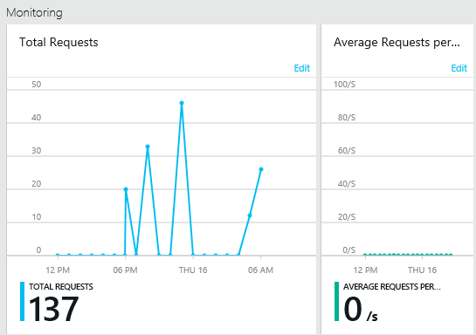
View performance metrics
In the Azure Portal, click Browse, DocumentDB Accounts, and then click the name of the DocumentDB account for which you would like to view performance metrics.
Within the Monitoring lens you can, by default, see:
Total requests for the current day
Average requests per second for the current day

Slide 49
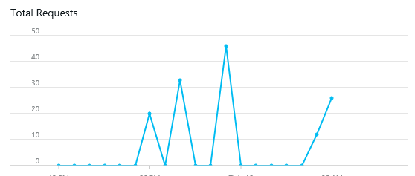

Customize performance metric views
To customize the metrics that display in a particular part, right-click the metric chart, and then select Edit Chart.

Slide 50
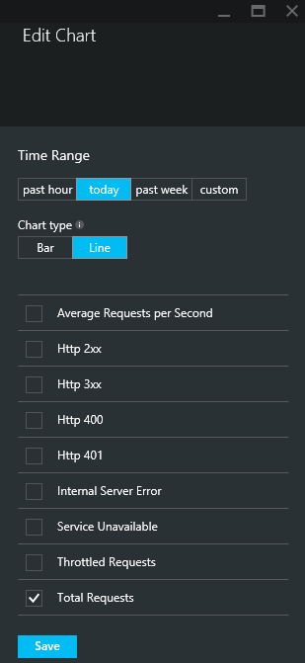
Customize performance metric views
On the Edit Chart blade, there are options to modify the metrics that display in the part, as well as their time range.

Slide 51
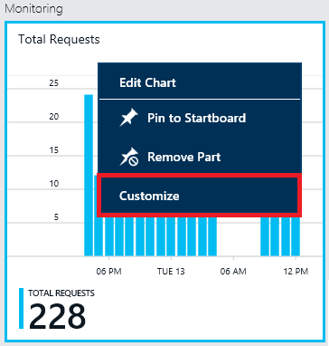
Create side-by-side performance metric charts
The Azure Portal allows you to create side-by-side metric charts.
Right-click on the chart you want to clone or modify and then click Customize.

Slide 52
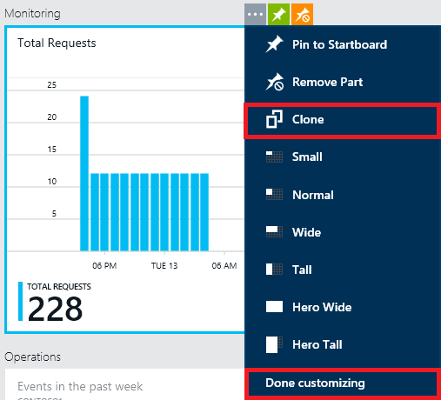
Create side-by-side performance metric charts
Click Clone on the menu to copy the part, and then click Done customizing.

Slide 53
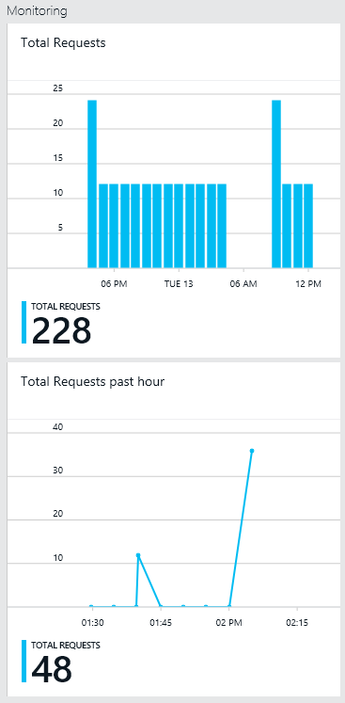
Create side-by-side performance metric charts
You may now treat this part as any other metric part, customizing the metrics and time range displayed in the part. This allows you to see two different metrics charts side-by-side at the same time.

Slide 54
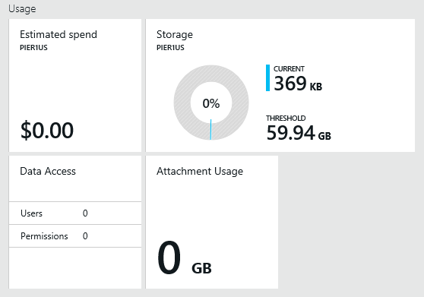
View usage metrics
In the Azure Portal, click Browse, DocumentDB Accounts, and then click the name of the DocumentDB account for which you would like to see usage metrics.
Within the Usage lens you can view the following by default:
Estimated cost
Storage consumed within the account
Maximum available storage of the account
User information
Attachment usage

Slide 55
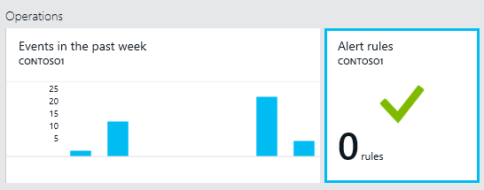
Set up performance metric alerts
In the Azure Portal, click Browse, DocumentDB Accounts, and then click the name of the DocumentDB account for which you would like to set up performance metric alerts.
Within the Operations lens, click the Alert rules part.

Slide 56
Manage an account
How to:
View, copy, and regenerate DocumentDB access keys
Manage DocumentDB consistency settings
Manage DocumentDB capacity settings
Delete a DocumentDB account

Slide 57
View, copy, and regenerate access keys
When you create a DocumentDB account, the service generates two master access keys that can be used for authentication when the DocumentDB account is accessed. By providing two access keys, DocumentDB enables you to regenerate the keys with no interruption to your DocumentDB account.
In the Azure management preview portal, access the Keys part from your DocumentDB Account blade All settings command to view, copy, and regenerate the access keys that are used to access your DocumentDB account.

Slide 58
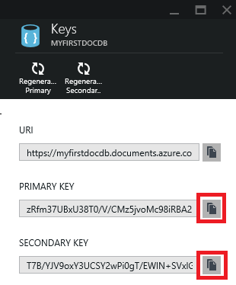
View and copy an access key
In the Azure Portal, access your DocumentDB account.
In the Summary lens, click Keys.
On the Keys blade, click the Copy button to the right of the key you wish to copy.

Slide 59
Regenerate access keys
Change the access keys to your DocumentDB account periodically to help keep your connections more secure. Two access keys are assigned to enable you to maintain connections to the DocumentDB account using one access key while you regenerate the other access key.
If you have applications or cloud services using your DocumentDB account, you will lose the connections if you regenerate keys, unless you roll your keys.

Slide 60
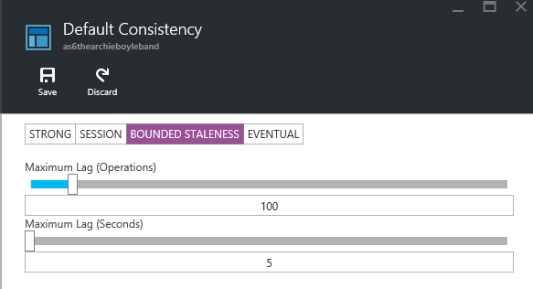
Specify the default consistency
In the Azure management preview portal, access your DocumentDB account.
In the Configuration lens, click Default Consistency.
On the Default Consistency blade, select the default consistency level you want for your DocumentDB account.
Click Save.
Monitor the progress of the operation via the Azure management preview portal Notifications hub.
Note that it can take several minutes before a change to the default consistency setting takes affect across your DocumentDB account.

Slide 61
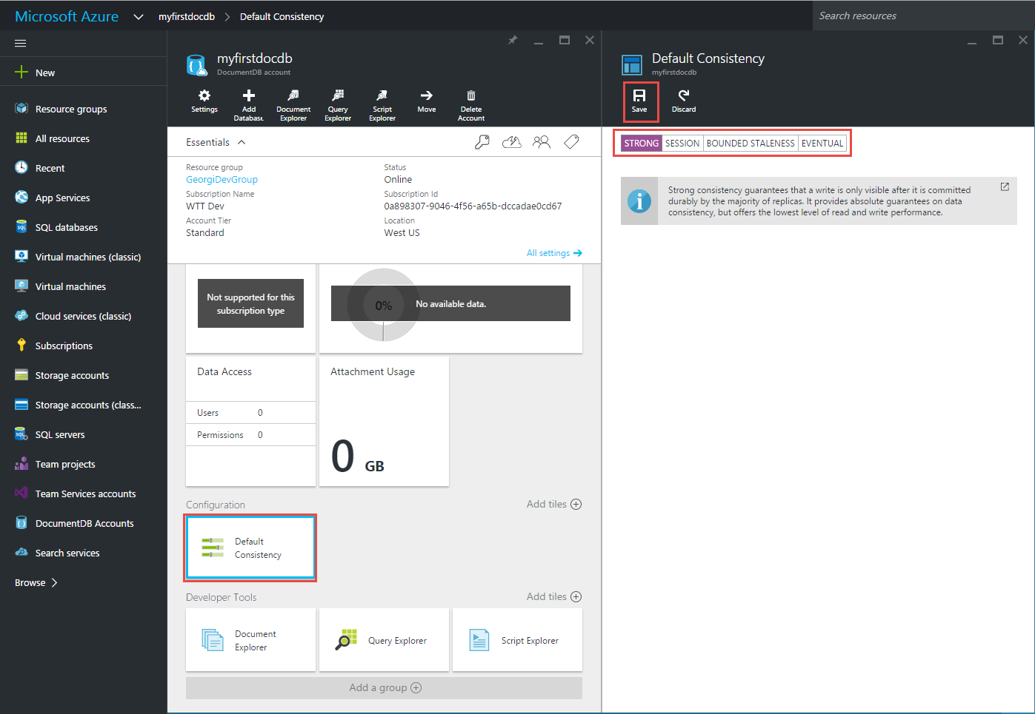
Specify the indexing policy
In the Azure management portal, access your Azure DocumentDB account.
In the Configuration lens, click Default Consistency.
On the Default Consistency blade, select the default consistency level that you want for your Azure DocumentDB account.
Click Save.
Monitor the progress of the operation via the Azure management portal Notifications hub.
Note that it can take several minutes before a change to the default consistency setting takes effect across your Azure DocumentDB account.

Slide 62
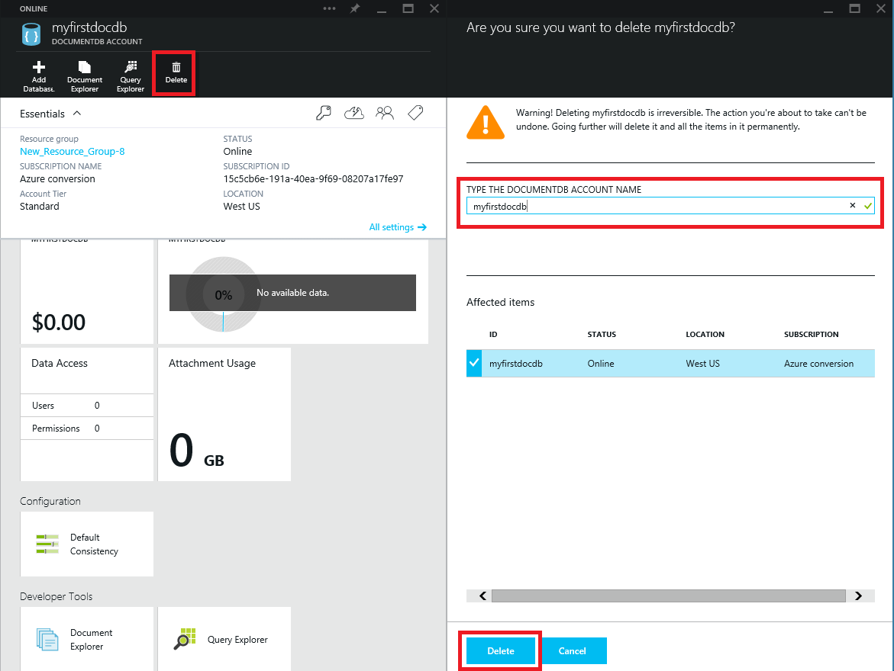
Delete a DocumentDB account
In the Azure management preview portal, access the DocumentDB account you wish to delete.
On the DocumentDB Account blade, click Delete.
On the resulting confirmation blade, type the DocumentDB account name to confirm that you want to delete the account.
On the confirmation blade, click Delete.
Warning: There is no way to restore the content from a deleted DocumentDB account.
Deleting a DocumentDB account will delete all of the account’s resources, including databases, collections, documents, and attachments.

Slide 63
Agenda
Overview
NoSQL and DocumentDB
Value Proposition
Azure DocumentDB Basics
Demo: Account Creation
Queries, transactions, indexing, Security
Management
Tools
Summary

Slide 64
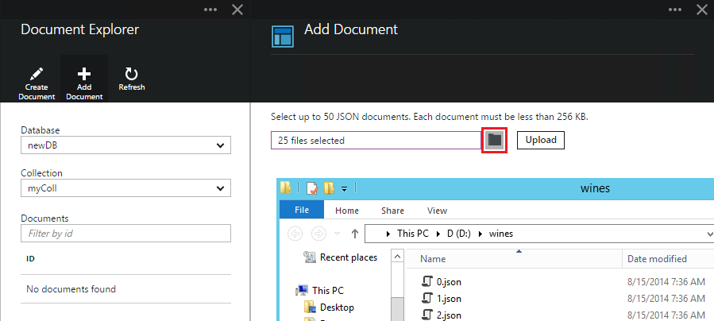
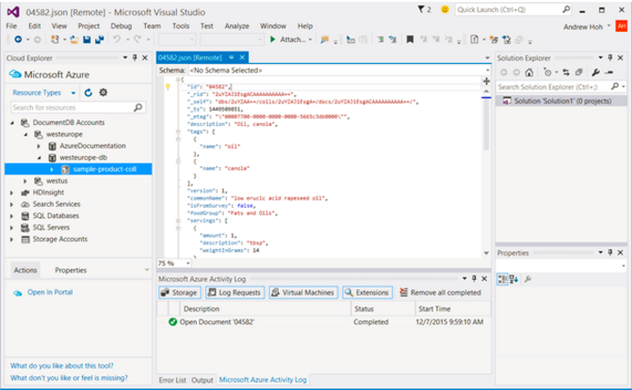
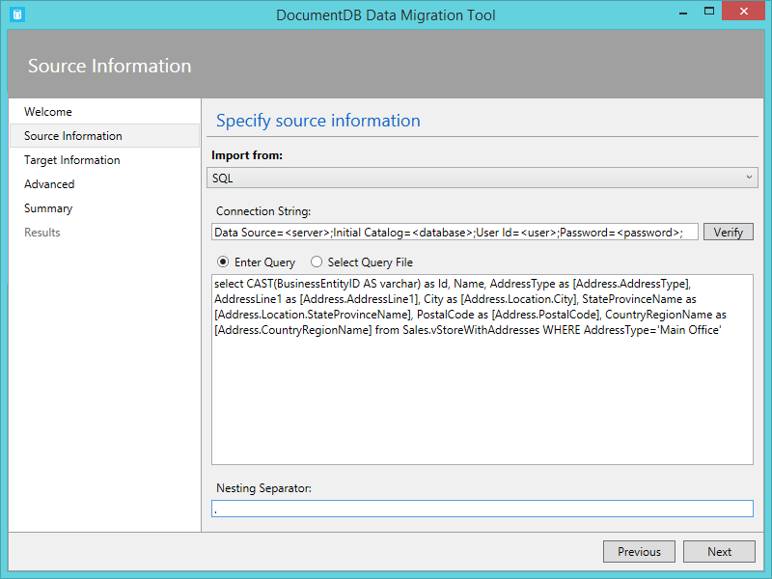
Tools
Document Explorer in Azure portal
Microsoft Cloud Explorer for Visual Studio
Azure DocumentDB data-migration tool
http://portal.azure.com
https://azure.microsoft.com/en-us/blog/exploring-azure-documentdb-in-visual-studio/
https://azure.microsoft.com/en-us/documentation/articles/documentdb-import-data/

Slide 65
Agenda
Overview
NoSQL and DocumentDB
Value Proposition
Azure DocumentDB Basics
Demo: Account Creation
Queries, transactions, indexing, Security
Management
Tools
Summary

Slide 66
DocumentDB is particularly suited for web and mobile applications
Catalog data
Preferences and state
Event store
User generated content
Data exchange
Gaming

Slide 67
Azure DocumentDB service summary
Unique among NoSQL stores:
Developed for the cloud and for delivery as a service
Truly query-able JSON store
Transactional processing through language-integrated JavaScript
Predictable performance and tunable consistency
Notes:
To recap, there are a few key points we want you to take a way from this presentation today.
DocumentDB is unique among NoSQL stores
It was developed and is delivered as a service on Azure
It’s truly schema-free and queryable using SQL
It has transactional processing just like a relational database
It has predictable performance and tunable consistency in the cloud.
Go talk to your customers, find out where document databases are being explored, trialed, or used in production and tell them about DocumentDB.
.

Slide 68
Build your first Azure DocumentDB app today
Get started
Sign up for Azure DocumentDB at http://aka.ms/docdbstart
Access and configure your account at http://portal.azure.com
Download an SDK from http://aka.ms/docdbsdks, and then build a sample at http://aka.ms/docdbsample
Get support
Schedule a 1:1 chat directly with the Azure DocumentDB engineering team at askdocdb.com
Give feedback
Ask questions through the forum at http://aka.ms/docdbforum
Suggest an idea and vote to support other ideas for Azure DocumentDB at http://aka.ms/docdbideas
On Twitter @documentdb

Slide 69
Thank you!
© 2015 Microsoft Corporation. All rights reserved. Microsoft, Windows, Windows Vista and other product names are or may be registered trademarks and/or trademarks in the U.S. and/or other countries.
The information herein is for informational purposes only and represents the current view of Microsoft Corporation as of the date of this presentation. Because Microsoft must respond to changing market conditions, it should not be interpreted to be a commitment on the part of Microsoft, and Microsoft cannot guarantee the accuracy of any information provided after the date of this presentation. MICROSOFT MAKES NO WARRANTIES, EXPRESS, IMPLIED OR STATUTORY, AS TO THE INFORMATION IN THIS PRESENTATION.

